Slide 1


Welcome!
Jay Janarthanan Project Manager
Microsoft NZ

Slide 2
You’ve come to the right room!

Slide 3
msa.ms/drive msa.ms/github
Resources:

Slide 4
Microsoft Student Accelerator!
Training from MSPs (students) for students
Supported by Microsoft
Training + Work Placement
Meet people, learn new things and have fun along the way!

Slide 5
The Plan for Today
Time | Topic
10:00am | Intro and Assessment Criteria
11:00am | Source Control
12:00pm | Lunch
1:00pm | Quiz
1:30pm | Intro to Web
3:00pm | Break
3:15pm | Advanced Web
5:00pm | Close / Questions

Slide 6
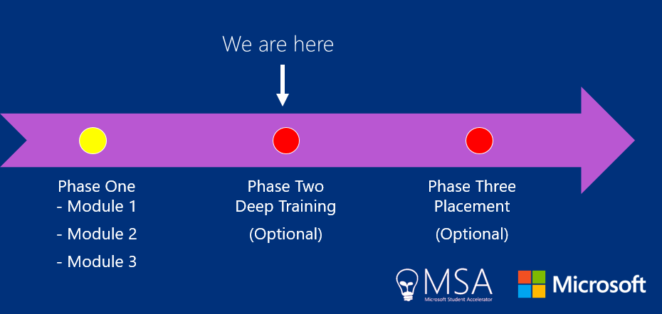
Key Dates & Progress

Slide 7
Need Help?
MSA Facebook Group! – Drop Deep SeaDev a line!
nzedu@microsoft.com

Slide 8
Key Dates & Progress
Date | Agenda
17 November | Phase 2 Camp
18 November | Phase 2 Camp
24 November | Assessments
25 November | Imagine Cup / Placements

Slide 9
Pre–Requisites
MVA Content on C# (Phase One)
Built a Windows app and familiar with Windows
Visual Studio + Windows / Mac

Slide 10
Assessments

Slide 11
Assessments - Deliverables
Required:
Web
API
Optional:
Authentication
JQuery Plug-ins
Cross-Platform Hosted App
Source-Controlled via GitHub and Managed via Visual Studio Online

Slide 12
Assessments - Scenarios
Two main scenarios
Contoso
Nandoso
Feel free to make your own scenario that has a similar workload

Slide 13
Assessments - Presentations
15-minute time slots
7-9 minutes of Presentation
Slides
Introduce yourself
Explain your Scenario
Demo your solution
3-5 minutes of Questions and Answers

Slide 14
Assessments
To be placed, you must complete assessment
In person only
Time Slot booking will be released soon

Slide 15
Key Advice & Tips
Every student that passes assessments will be placed
Self learning is the best learning
Use us as a guide and not gospel
HAVE YOUR DEV ENVIRONMENT READY TO GO

Slide 16
Any Questions on Assessments?

Slide 17
Groupings

Slide 18
Groupings
Based on Assessments
You give your preferences
We try to make the best match between skills, type of projects and your preferences!

Slide 19
Imagine Cup

Slide 20
Imagine Cup
More details to be shared
Fun team-building group exercise

Slide 21
Employer Matching

Slide 22
Employers
A pool of employers
Student Teams give their preferences
A panel of MSPs/Assessors will match the employers based on skills, projects and preferences!
More details to follow…

Slide 23
Feedback Form
Coming later today!

Slide 24
Any Questions?

